Slide 1

Seminar
Topic
Principal Component Analysis (PCA)
Name – Ranjan Sarkar
Roll – 21MA40022
2-Year MSc, 2nd Year
Department of Mathematics, IIT Kharagpur
E-mail Id – ranjansarkar717@kgpian.iitkgp.ac.in
Date – September 14, 2022
Indian Institute of Technology
Kharagpur

Slide 2

Content
Introduction
PCA Method
Geometric Interpretation
Mathematical Formulation
Applications
References

Slide 3
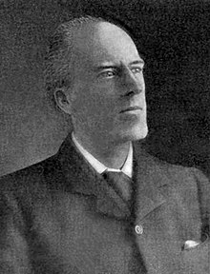
Introduction
PCA was invented in 1901 by British Mathematician and Biostatistician Karl Pearson, as an analogue of the principal axis theorem in mechanics; it was later independently developed and named by Harold Hotelling in the 1930s.
This method becomes too popular nowadays in Machine Learning for the sudden growth of the data. To reduce the dimension of higher-dimensional data and to visualize it, we use it.

Slide 4
What is Principal Component?
Introduction
The principal components of a collection of points in a real coordinate space are a sequence of p unit vectors, where the i^{th} vector is the direction of a line that best fits the data while being orthogonal to the first i-1 vectors.
Here, a best-fitting line is defined as one that minimizes the average squared perpendicular distance from the points to the line.
These directions constitute an orthonormal basis in which different individual dimensions of the data are linearly uncorrelated.
Principal Component Analysis (PCA) is the process of computing the principal components and using them to perform a change of basis on the data, sometimes using only the first few principal components and ignoring the rest. PCA is a statistical procedure which uses an orthogonal transformation to reduce the dimension of a data (i.e., no. of attributes / number of columns in a given data matrix)

Slide 5
Description
PCA Method
 | Feature (1) | Feature (2) | Feature (3) | … | … | Feature (N)
Sample 1 | 129 | 55 | 1.2 | … | … | 512
Sample 2 | 22 | 10 | 2.2 | … | … | 543
Sample 3 | 107 | 33 | 4.1 | … | … | 123
. . . | . . . | . . . | . . . | … … … | … … … | . . .
Sample k | 66 | 33 | 3.9 | … | … | 726
This is basically a k x N Matrix A, whose Columns are the Features and Rows are the Samples.
For large values of N, we need to find p << N so that we can use a k x p Matrix A’ in place of A which can describe the data of almost fully.
A

Slide 6
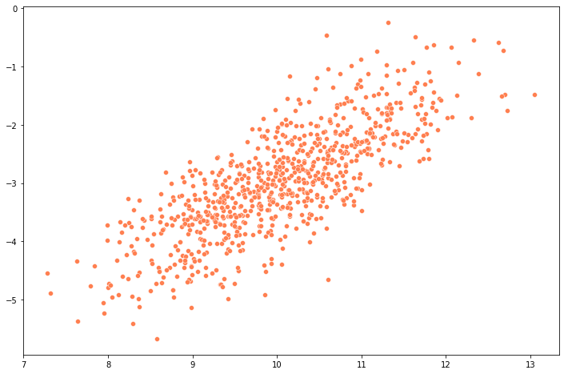
Geometrical Interpretation
PCA Method
PC1 describes the maximum variance of the data.
After PC1, PC2 describes the variance of the data as 2nd maximum.
PC1
PC2
Goal
to find the direction of these PC1, PC2…

Slide 7
Geometrical Interpretation
PCA Method
For PC1, we will find a direction which can describe the variance of the data mostly.
PC1
Basically, each Principal Component direction is the Linear Combination of the existing axis.
Then, we will project the data on the direction of the PCs.
Goal
to find the PC1, we have to
Maximize [Var (projected data)]
Notes:
Describe the Linear transformation to a orthogonal basis

Slide 8


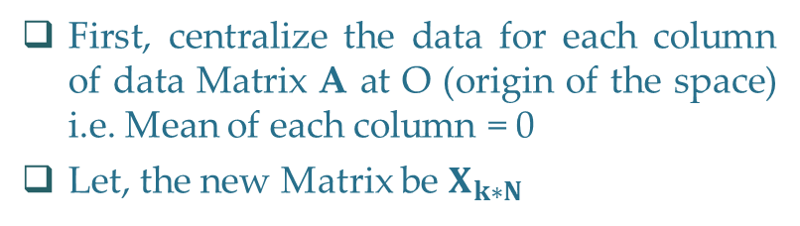

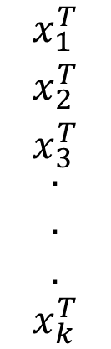






Problem Framing
PCA Method
For, j^{th} column (j = 1, 2, 3, …, N)
First, centralize the data for each column of data Matrix A at O (origin of the space) i.e. Mean of each column = 0
Let, the new Matrix be $X_{k∗N}$
$$x_{ij}=a_{ij}−\overline{a_{j}}$$
$$∀ i=1, 2, 3, …, k$$
$$\begin{matrix}x_{1}^{T} \\ \begin{matrix}x_{2}^{T} \\ x_{3}^{T} \\ \begin{aligned}. \\ . \\ .\end{aligned}\end{matrix} \\ x_{k}^{T}\end{matrix}$$
$$\sum_{i=1}^{k}{ }$$
We have rows of the X as a Data Point in N-dim space.
We are projecting this rows along Unit Vector of PC1.
$$X=$$
$$2$$
$$Max$$
$$( )$$
$${(x_{i})}^{T}\hat{u}$$
$s.t$., $u^{T}u=1$

Slide 9
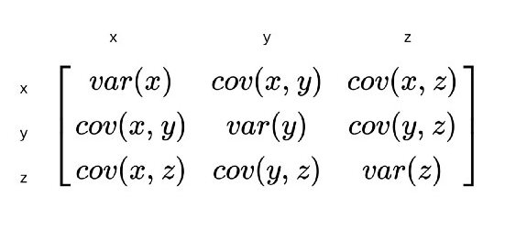





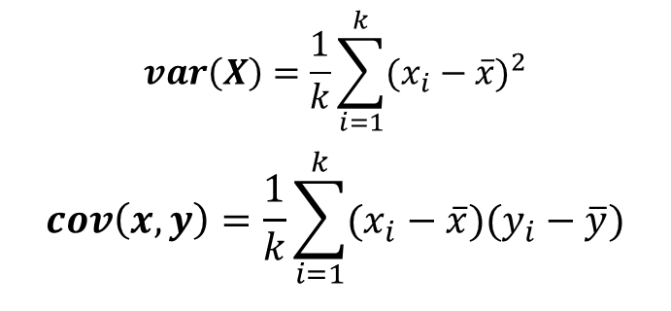






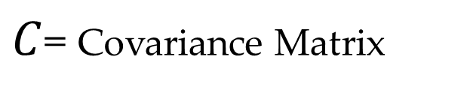
Mathematical Formulation
PCA Method
$$\sum_{i=1}^{k}{ }$$
$$2$$
$$( )$$
$$C$$
$C$= Covariance Matrix
$$Max$$
$${(x_{i} x_{i}}^{T})$$
$${(x_{i})}^{T}\hat{u}$$
$$\hat{u}$$
$${(x_{i})}^{T}\hat{u}$$
$${( \hat{u} )}^{T}x_{i}$$
$${\hat{u}}^{T}$$
$$var\left(X\right)=\frac{1}{k}\sum_{i=1}^{k}{{(x_{i}−\overline{x})}^{2}}$$
$$cov\left(x,y\right)=\frac{1}{k}\sum_{i=1}^{k}{(x_{i}−\overline{x})(y_{i}−\overline{y})}$$

Slide 10
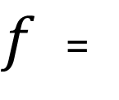
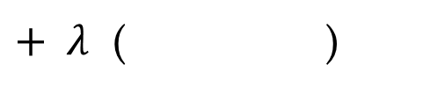



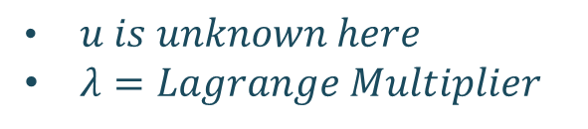









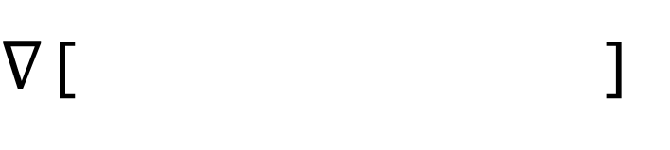

Solving the Maximization Problem by using Lagrange Multiplier Method
PCA Method
$f$ =
$$C$$
$$∇$$
$$Max$$
$∇$ [ ]
$u is unknown here$
$λ=Lagrange Multiplier$
$+ λ$ ( )
$$u^{T}u 1$$
$${\hat{u}}^{T}$$
$$\hat{u}$$
$$=$$
$$−$$
$$=2C\hat{u}−2λ\hat{u}=0$$
So, we are finding the maximum Eigen Value of the Covariance Matrix.
Since, Covariance Matrix is symmetric and positive semi-definite, so every eigen value will be a non-negative real number and corresponding Eigen Vectors are orthogonal.
By arranging the eigen values in descending order, we will find the sequence of Eigen Vectors which will give the Principal Components.
$$⇒Cu=λu$$
$λ$ is Eigen Value of $C$
$$⇒ u^{T}Cu =λu^{T}u$$
$$⇒ u^{T}Cu =λ$$

Slide 11
Process to Find Principal Components
PCA Method
First, Calculate the Covariance Matrix (C )
Then, Find the Eigen Values of C and arrange them in descending order.
After getting that descending sequence of Eigen Values, write down the Eigen Vectors corresponding to those eigen values.
Finally, PC1 will be the Eigen Vector corresponding to the highest Eigen Value, PC2 will be the Eigen Vectors corresponding to the Second Highest Eigen Value and So on.
Furthermore, you can calculate the Contribution Score of each PC.
According to the contribution, you choose some of the Principal Components.

Slide 12
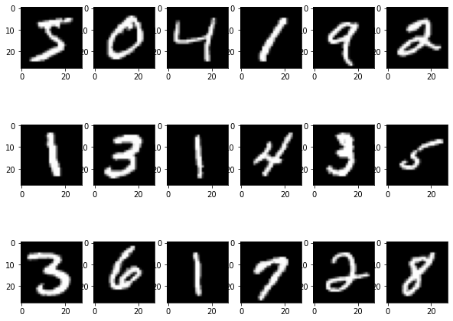
Visualization of a 28x28 (=784) dim Image data in 2D
Application
This is a sample of 28x28 pixel Image Dataset.
We need 28*28 = 784 values (Grayscale pixel value Range: 0 – 255) to describe a single image.
Each Datapoint is a point in 784 dim Space which can’t be visualized.
So, we need PCA to transform this data to a lower version of itself.

Slide 13
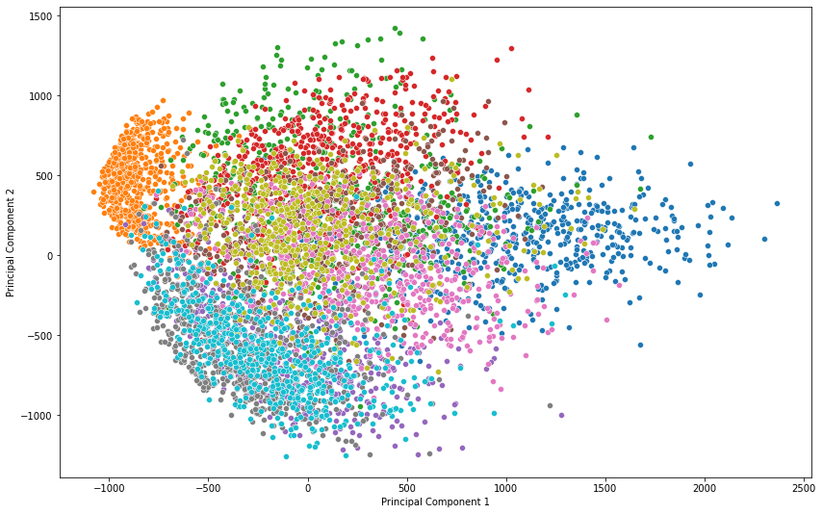
Visualization of a 28x28 (=784) dim Image data in 2D
Application
After applying PCA, we transformed the higher dimensional data to it’s best 2 dimensional representation.
Each color denotes a different numbers between 0 to 9.
0
1
2
3
4
5
6
7
8
9

Slide 14
Applications
PCA is predominantly used as a dimensionality reduction technique in domains like
Facial Recognition Pattern Recognition
Computer Vision Image Compression
Visualization Time Series Prediction
PCA is used to preprocess the raw data before putting it in Machine Learning model.
It is often used to help in dealing with multi-collinearity before a model is developed.
PCA is also applied in Healthcare industries in multiple areas like patient insurance data where there are multiple sources of data and with a huge number of variables that are correlated to each other.

Slide 15
References
G. T. Reddy et al., "Analysis of Dimensionality Reduction Techniques on Big Data," in IEEE Access, vol. 8, pp. 54776-54788, 2020, doi: 10.1109/ACCESS.2020.2980942. Link: IEEE Xplore Full-Text PDF
Chapter 2: 12.2. PCA (Page: 498 – 510) of the Book: An Introduction to Statistical Learning (ISLR) Version 2
Wikipedia: Principal component analysis – Wikipedia
Some YouTube Channels to understand it Visually:
StatQuest with Josh Starmer | PCA Step-by-Step
Visually Explained | PCA
Serrano.Academy | PCA

Slide 16

Thank You!
by: Ranjan Sarkar

